Slide 1



Character
Character Key Actions
Module I: Impact of Character (30 minutes)
Objectives
Self-Assessment – Say Yes or No
Importance of Character: Employee, Leader and Organization
Demonstrate Character - at home, at work, and in your community
Quote to Ponder
Module II: Pillars of Character (30 minutes)
Objectives
Pillars of Character
Case Study: Mindset - Treat every person you encounter with dignity and respect
Case Study: Mindset - What we think, we become
Quote to Ponder
Module III: Build Your Character (30 minutes)
Objectives
Discussion – Culture & Diversity, Conflict and Unethical behavior
Build Your Character – Having, Doing and Being
Character Vocabulary in Communication
Quote to Ponder
Page 1

Slide 2


Core Value: Character
Page 2
Notes:
Do: Conduct introductions as needed.​
​
Say: Welcome to the session for one of our core values, Character.
​
Do: Show next slide.

Slide 3
Overview
The RealPage Core Values - Manager Learning Resources aim to help ensure alignment of the core values’ definition throughout RealPage. RealPage leaders and teammates will have thoughtful conversations and engage in helpful activities that will help them embody the core values’ key actions.
Character
Good character builds the trust needed for success. These learning resources aim to help participants develop their character by creating awareness of the areas they can improve on, exploring the importance and pillars of character and providing tools to build character.
Module I: Impact of Character
Character is best shown when no one is watching. This first module aims to help participants take a close look at their actions to realize areas of character that they can or need to improve on. They will also explore the importance of good character as an employee or a leader and to the organization helping them move towards development.
Module II: Pillars of Character Model
In this second module, participants will have a better understanding of what is considered ethical through the four pillars of character. They will also have an opportunity to discuss behavior that they want to improve and how they can do it. Then, through case studies they will determine actions that could improve character.
Module III: Build Your Character
The first two modules focus on self-awareness and understanding the behaviors that comprise good character. In this third module, learners will explore tools to help build their character and to promote good character when communicating with others.
Page 3

Slide 4
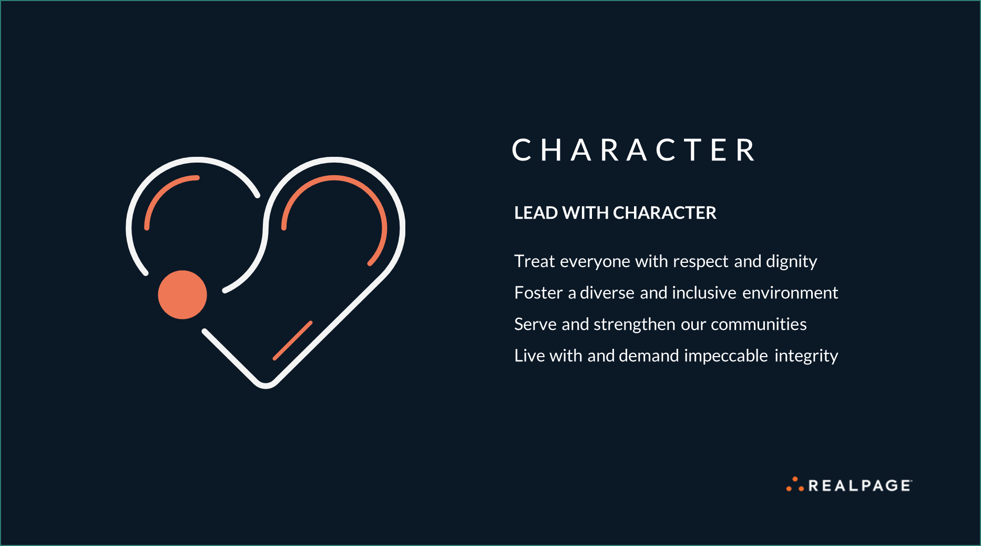
Page 4
Notes:
Say: To start, let’s review the key actions of Character! I’ll give you a few seconds to read through the slide.​
​
Say: Plainly said, character is about showing respect for one another. It’s also being inclusive in the workplace, respecting what everyone brings to the table. Moreover, it’s about making decisions with utmost integrity, and leading with our hearts as we serve the communities where we live and work. This is how we LEAD WITH CHARACTER.​
​
Transition: Let's look at the objective of today’s session.

Slide 5

Module III
Build Your Character: Objective
Equip oneself with information to build character
C H A R A C T E R
Page 5
Notes:
Do: Share the objective and transition to the next slide.

Slide 6

I Wish I Were…
Gordon H. Taggart
honest enough to admit all my shortcomings;
brilliant enough to accept flattery without it making me arrogant;
tall enough to tower above deceit;
strong enough to treasure love;
brave enough to welcome criticism;
compassionate enough to understand human frailties;
wise enough to recognize my mistakes;
humble enough to appreciate greatness;
staunch enough to stand by my friends;
human enough to be thoughtful of my neighbor; and
righteous enough to be devoted to the love of God.
C H A R A C T E R
Page 6
Notes:
Say: Here are a few lines I picked from the poem written by Gordon H. Taggart. I’ll give you some time to read it and afterwards, let me know what you think.
Do:
Call one or two participants to share what they think of the poem.
Acknowledge, ask follow up questions or redirect answers, as necessary.
Ask: Say you were in place where you thought you were not being noticed and you did something horrific that became news. The next day, you are trending on social media, how would that make you feel? How would it make your loved ones feel if they knew you acted this way?
Say: You've probably heard this quote by legendary college basketball coach, John Wooden: “The true test of a man's character is what he does when no one is watching.”
Transition: Let’s learn how we can build character.

Slide 7




Build Your Character
C H A R A C T E R
HAVING
the right values
DOING
the right thing
BEING
the right kind of person
Page 7
Notes:
Say: As Robert Freeman puts it, "Character is not made in a crisis; it is only exhibited.“ Hard times reveal who we really are and what we are made of. So how do we build character?
It can be built by keeping three points in mind, “Having the right values, Doing the right thing and Being the right kind of people.”
Ask: Why is it important to have the right values?
Do:
Call a participant if no one volunteers.
Acknowledge, ask follow up questions or redirect, as necessary.
Say: HAVING the right values creates feelings of happiness, satisfaction and fulfilment, and helps us develop healthy patterns of behavior. It also connects and helps us develop meaningful relationships.
Say: The next thing to remember is to DO the right thing. People with good character know that there’s never a wrong time to do the right thing. As William Bady, Jr., a builder and developer said, “Living a life is like constructing a building: If you start wrong, you’ll end wrong.”
Ask: What do you do when it’s hard to do the right thing?
Do:
Call a participant if no one volunteers.
Acknowledge, ask follow up questions or redirect, as necessary.
Say: The last thing that will help build character is to Be the right kind of person. Take a look at how you behave in different situations to see where you need to grow your character. No matter where you stand currently, you can make the choice to change. Make choices that correspond with your beliefs and values.
Transition: Now that we’ve talked about how we can build character, let’s have an activity.

Slide 8

Activity
1. How can you promote a culture of inclusion and diversity in the workplace?
2. When you have conflict in opinions during a project with a team member, how do you present it?
3. Have you come across any unethical behavior from anyone at work. If yes, how did you deal with it?
C H A R A C T E R
Page 8
Notes:
Duration: 10 min
Facilitator notes:
This can be a breakout room activity or general discussion in the session.
Give one question per team if this is a breakout session.
Ask: How do you promote a culture of inclusion and diversity in the workplace?
Sample Answer:
Inclusion is acknowledging the strengths of each employee and the potential they bring to workplace. We need to value and respect differences, like language, race, color, gender, religion, disability, gender identity, and family structures, etc.
Ask: When you have conflict in opinions during a project with the team member, how do you present it?
Sample Answer:
Build cooperative attitude. Focus and respect multiple viewpoints and insights, the end goal is to be united, efficient, and happy in the workplace.
Ask: Have you come across any unethical behavior from anyone at work. If yes, how did you deal with it?
Sample Answer: (Provide hotline number or email to address unethical behavior)
An employee shared his innovative idea to his colleague. The colleague shared the same idea with their manager; however, did not give credit to the right person. When the idea was announced, the employee reached out to manager to know who proposed the same idea, and he was disappointed to know that his colleague stole his idea.
The manager called them together to clarify and told them that it’s important to respect each other. To be fair, the manager arranged a team meeting and asked the employee to talk about the idea in details and gave him the credit. The manager portrayed the values like responsibility, trust and respect.
Do: Show next slide.

Slide 9
Activity: Brainstorm words that describe "Character"
Page 9
Notes:
Do:
- This can be done individually or in teams.
- Allow 5 minutes to get responses.

Slide 10

Character Vocabulary in Communication
Below are some examples of words that can describe someone's character.
What other words did you come up with?
Honest
Moral
Righteous
Virtuous
Honorable
Appropriate
Ethical
Inclusive
Integrity
Resilient
Collaborative
Truthful
Fair
Sincere
Transparent
Accountable
Credible
Reliable
C H A R A C T E R
Page 10
Notes:
Duration: 5 minutes
Say: It’s said, "In words are seen the state of mind, character and disposition of the speaker"- Plutarch (Greek philosopher, historian, biographer)
Facilitator notes: What you say reflect your state of mind and so, your character. Be mindful of the words you use every day when you interact with others.
Say: Here are few words closely associated to promote character when communicating with others. You can use this character vocabulary during team meetings, emails, teams chat, meetings and in huddles to help build people’s character.
Examples –
During interviews: “Tell us about the time you portrayed accountability at your workplace or in your current role?”
Review and feedback : “You work with utmost sincerity and fairness with the work assigned to you”.
Reward and recognize : “Kudos to your inclusive and truthful approaches”.
With customers: “Thank you for being transparent and honest with your feedback on our tool”.

Slide 11
“Be more concerned with your character than your reputation, because your character is what you really are, while your reputation is merely what others think you are.”
-John Wooden
American basketball coach and seven times winner
of Henry Iba Award as coach of the year
Page 11
Notes:
Optional discussion: What is the difference between the character and reputation?
Sample answer for discussion or quote explanation: Character can be defined as the distinctive qualities of an individual. Usually, when we refer to a person as one with a good character, it implies that the person has good qualities and lives by a sound moral and ethical code.
On the other hand, reputation refers to the general opinion held by others of an individual. The main difference between the two concepts is that while the character is more internal, reputation is rather external.

Slide 12
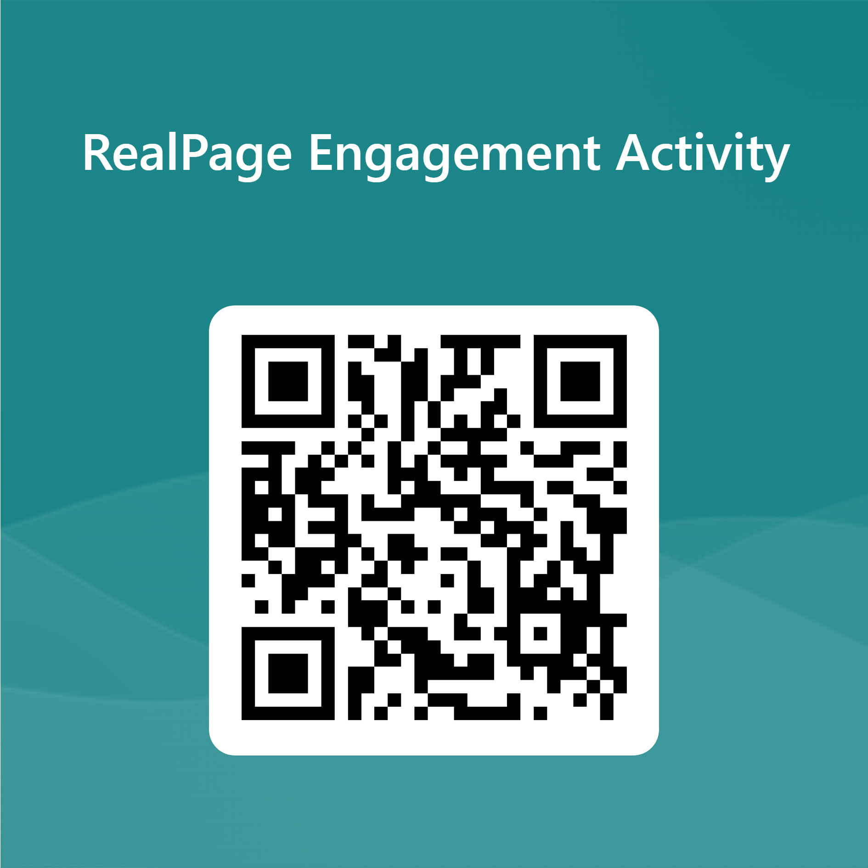
Please sign your attendance by scanning the QR code or clicking the attendance link.
Attendance and Feedback QR Code:
Attendance and Feedback link: https://forms.office.com/r/p1UepZ5W1F
Page 12

Slide 13
Thank you.
C H A R A C T E R
Page 13

